Slide 1





Your Global Technology Outsourcing Partner
EPAM POWER POINT TITLE
DB for developers
Sub Topic
RDBMS introduction
® 2004. EPAM Systems. All rights reserved.

Slide 2
Data Storage on Different Media
SALGRADE
GRADE LOSAL HISAL
--------- --------- ---------
1 700 1200
2 1201 1400
3 1401 2000
4 2001 3000
5 3001 9999
DEPT
DEPTNO DNAME LOC
--------- -------------- ---------- 10 ACCOUNTING NEW YORK
20 RESEARCH DALLAS
30 SALES CHICAGO
40 OPERATIONS BOSTON
Database
Electronic spreadsheet
Filing cabinet
Notes:
Storing Information
Every organization has some information needs. A library keeps a list of members, books, due dates, and fines. A company needs to save information about employees, departments, and salaries. These pieces of information are called data.
Organizations can store data on various media and in different formats—for example, a hard-copy document in a filing cabinet or data stored in electronic spreadsheets or in databases.
A database is an organized collection of information.
To manage databases, you need database management systems (DBMS). A DBMS is a program that stores, retrieves, and modifies data in the database on request. There are four main types of databases: hierarchical, network, relational, and more recently object relational.
Note: Oracle7 is a relational database management system and Oracle8 is an object relational database management system.

Slide 3
Relation Database Concept
  Dr. E.F. Codd proposed the relation model for database system in 1970.
  It is the basic for the relation database management system (RDBMS).
  The relation model consists of the following:
    Collect of objects or relations
    Set of operators to act on the relations
    Data integrity for accuracy and consistency
Notes:
Relational Model
The principles of the relational model were first outlined by Dr. E. F. Codd in a June 1970 paper called “A Relational Model of Data for Large Shared Data Banks.” In this paper, Dr. Codd proposed the relational model for database systems.
The more popular models used at that time were hierarchical and network, or even simple flat file data structures. Relational database management systems (RDBMS) soon became very popular, especially for their ease of use and flexibility in structure. In addition, there were a number of innovative vendors, such as Oracle, who supplemented the RDBMS with a suite of powerful application development and user products, providing a total solution.
Components of the Relational Model
Collections of objects or relations that store the data
A set of operators that can act on the relations to produce other relations
Data integrity for accuracy and consistency
For more information, see E. F. Codd, The Relational Model for Database Management Version 2 (Reading, Mass.: Addison-Wesley, 1990).

Slide 4
Definition of a Relation Database
A relation database is a collect of relations or two-dimensional tables.
Database
Table name: EMP
Table name: DEPT
EMPNO ENAME JOB DEPTNO
7839 KING PRESIDENT 10
7698 BLAKE MANAGER 30
7782 CLARK MANAGER 10
7566 JONES MANAGER 20
DEPTNO DNAME LOC
10 ACCOUNTING NEW YORK
20 RESEARCH DALLAS
30 SALES CHICAGO
40 OPERATIONS BOSTON
Notes:
Relational Database
A relational database uses relations or two-dimensional tables to store information.
For example, you might want to store information about all the employees in your company. In a relational database, you create several tables to store different pieces of information about your employees, such as an employee table, a department table, and a salary table.

Slide 5
Relation Database Management System (RDBMS)
Server
User tables
Data dictionary
Notes:
Relational Database Management System
Oracle provides a flexible RDBMS called Oracle7. Its features enable you to store and manage data with all the advantages of a relational structure plus PL/SQL, an engine that provides you with the ability to store and execute program units. The Server offers users the options of retrieving data based on optimization techniques. It includes security features that control how a database is accessed and used. Other features are that it has consistency and protection of data through locking mechanisms.
Oracle applications may run on the same computer as the Oracle Server. Alternatively, you can run applications on a system local to the user and run the Oracle Server on another system (client-server architecture). In this client-server environment, a wide range of computing resources can be used. For example, a form-based airline reservation application can run on a client personal computer while accessing flight data that is conveniently managed by an Oracle Server on a central computer.
For more information, see Oracle Server Concepts Manual, Release 8.0.

Slide 6
Data models
Model of system in clients’s mind
Entity model of clients’s model
Table model of entity model
Server
Tables on disk
Notes:
Data Models
Models are a cornerstone of design. Engineers build a model of a car to work out any details before putting it into production. In the same manner, system designers develop models to explore ideas and improve the understanding of the database design.
Purpose of Models
Models help communicate the concepts in people’s minds. They can be used for the following purposes:
Communicate
Categorize
Describe
Specify
Investigate
Evolve
Analyze
Imitate
The objective is to produce a model that fits a multitude of these uses, that can be understood by an end user and contains sufficient detail for a developer to build a database system.

Slide 7
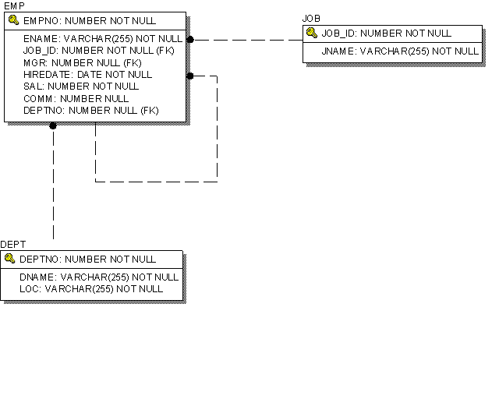
Entity Relationship Model
Notes:
ER Modeling
In an effective system, data is divided into discrete categories or entities. An entity relationship (ER) model is an illustration of various entities in a business and the relationships between them. An ER model is derived from business specifications or narratives and built during the analysis phase of the system development life cycle. ER models separate the information required by a business from the activities performed within a business. Although businesses can change their activities, the type of information tends to remain constant. Therefore, the data structures also tend to be constant.
Benefits of ER Modeling
Documents information for the organization in a clear, precise format
Provides a clear picture of the scope of the information requirement
Provides an easily understood pictorial map for the database design
Offers an effective framework for integrating multiple applications
Key Components
Entity: A thing of significance about which information needs to be known. Examples are departments, employees, and orders.
Attribute: Something that describes or qualifies an entity. For example, for the employee entity, the attributes would be the employee number, name, job title, hire date, department number, and so on. Each of the attributes is either required or optional. This state is called optionality.
Relationship: A named association between entities showing optionality and degree. Examples are employees and departments, and orders and items.

Slide 8
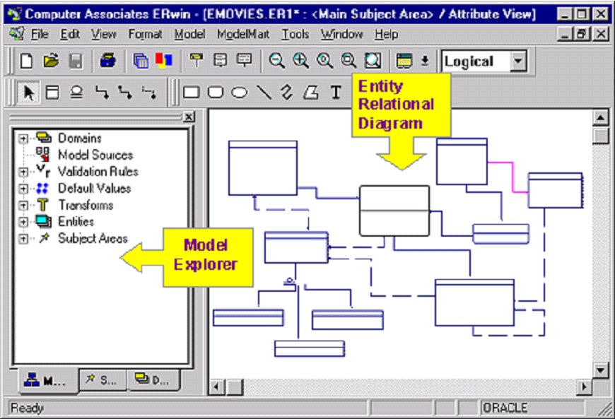
Database Modelling tools: Erwin

Slide 9
Relation Database Terminology
2
3
4
EMPNO ENAME JOB MGR HIREDATE SAL COMM DEPTNO
------------- ------------ --------------------- -------- ---------------- ----------- -------------- -----------
7839 KING PRESIDENT 17-NOV-81 5000 10
7698 BLAKE MANAGER 7839 01-MAY-81 2850 30
7782 CLARK MANAGER 7839 09-JUN-81 2450 10
7566 JONES MANAGER 7839 02-APR-81 2975 20
7654 MARTIN SALESMAN 7698 28-SEP-81 1250 1400 30
7499 ALLEN SALESMAN 7698 20-FEB-81 1600 300 30
7844 TURNER SALESMAN 7698 08-SEP-81 1500 0 30
7900 JAMES CLERK 7698 03-DEC-81 950 30
7521 WARD SALESMAN 7698 22-FEB-81 1250 500 30
7902 FORD ANALYST 7566 03-DEC-81 3000 20
7369 SMITH CLERK 7902 17-DEC-80 800 20
7788 SCOTT ANALYST 7566 09-DEC-82 3000 20
7876 ADAMS CLERK 7788 12-JAN-83 1100 20
7934 MILLER CLERK 7782 23-JAN-82 1300 10
6
5
1
Notes:
Terminology used in a Relational Database
A relational database can contain one or many tables. A table is the basic storage structure of an RDBMS. A table holds all the data necessary about something in the real world—for example, employees, invoices, or customers.
The slide above shows the contents of the EMP table or relation. The numbers indicate the following:
1. A single row or tuple representing all data required for a particular employee. Each row in a table should be identified by a primary key, which allows no duplicate rows. The order of rows is insignificant; specify the row order when the data is retrieved.
2. A column or attribute containing the employee number, which is also the primary key. The employee number identifies a unique employee in the EMP table. A primary key must contain a value.
3. A column that is not a key value. A column represents one kind of data in a table; in the example, the job title of all the employees. Column order is insignificant when storing data; specify the column order when the data is retrieved.
4. A column containing the department number, which is also a foreign key. A foreign key is a column that defines how tables relate to each other. A foreign key refers to a primary key or a unique key in another table. In the example, DEPTNO uniquely identifies a department in the DEPT table.
5. A field can be found at the intersection of a row and a column. There can be only one value in it.
6. A field may have no value in it. This is called a null value. In the EMP table, only employees who have a role of salesman have a value in the COMM (commission) field.
Note: Null values are covered further in subsequent lessons.

Slide 10
Relating Multiple Tables
  Each row of data in a table is uniquely identified by a primary key (PK).
  You can logiccaly relate data from multiple tables using foreign keys (FK).
Table name: EMP
Table name: DEPT
EMPNO ENAME JOB DEPTNO
7839 KING PRESIDENT 10
7698 BLAKE MANAGER 30
7782 CLARK MANAGER 10
7566 JONES MANAGER 20
DEPTNO DNAME LOC
10 ACCOUNTING NEW YORK
20 RESEARCH DALLAS
30 SALES CHICAGO
40 OPERATIONS BOSTON
Primary key
Foreign key
Primary key
Notes:
Relating Multiple Tables
Each table contains data that describes exactly one entity. For example, the EMP table contains information about employees. Categories of data are listed across the top of each table, and individual cases are listed below. Using a table format, you can readily visualize, understand, and use information.
Because data about different entities is stored in different tables, you may need to combine two or more tables to answer a particular question. For example, you may want to know the location of the department where an employee works. In this scenario, you need information from the EMP table (which contains data about employees) and the DEPT table (which contains information about departments). An RDBMS enables you to relate the data in one table to the data in another by using the foreign keys. A foreign key is a column or a set of columns that refer to a primary key in the same table or another table.
The ability to relate data in one table to data in another enables you to organize information in separate manageable units. Employee data can be kept logically distinct from department data by storing it in a separate table.
Guidelines for Primary Keys and Foreign Keys
No duplicate values are allowed in a primary key.
Primary keys generally cannot be changed.
Foreign keys are based on data values and are purely logical, not physical, pointers.
A foreign key value must match an existing primary key value or unique key value, or else be NULL.

Slide 11
Communicating with a RDBMS using SQL
SQL statement is entered
Statement is sent to DB
SQL> SELECT loc
2 FROM dept;
DB
Data is displayed
LOC
-------------
NEW YORK
DALLAS
CHICAGO
BOSTON
Notes:
Structured Query Language
SQL allows you to communicate with the server and has the following advantages:
Efficient
Easy to learn and use
Functionally complete. SQL allows you to define, retrieve, and manipulate data in the tables.

Slide 12
Relational Database Properties
A relation database:
  Can be accessed and modified by executing structured query language (SQL) statements
  Contains a collection of tables with no physical pointers
  Uses a set of operators
Notes:
Properties of a Relational Database
In a relational database, you do not specify the access route to the tables, and you do not need to know how the data is arranged physically.
To access the database, you execute a structured query language (SQL) statement, which is the American National Standards Institute (ANSI) standard language for operating upon relational databases. The language contains a large set of operators for partitioning and combining relations. The database can be modified by using the SQL statements.

Slide 13
Rules of Data Normalization

Slide 14
Eliminate Repeating Groups
1. Eliminate Repeating Groups
In the original member list, each member name is followed by any databases that the member has experience with. Some might know many, and others might not know any. To answer the question, "Who knows DB2?" we need to perform an awkward scan of the list looking for references to DB2. This is inefficient and an extremely untidy way to store information.
Moving the known databases into a seperate table helps a lot. Separating the repeating groups of databases from the member information results in first normal form. The MemberID in the database table matches the primary key in the member table, providing a foreign key for relating the two tables with a join operation. Now we can answer the question by looking in the database table for "DB2" and getting the list of members.

Slide 15
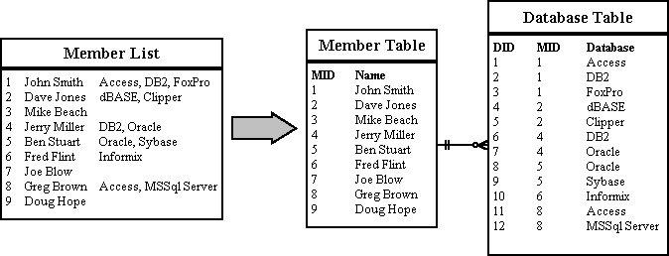
Eliminate Repeating Groups

Slide 16
Eliminate Redundant Data
2. Eliminate Redundant Data
In the Database Table, the primary key is made up of the MemberID and the DatabaseID. This makes sense for other attributes like "Where Learned" and "Skill Level" attributes, since they will be different for every member/database combination. But the database name depends only on the DatabaseID. The same database name will appear redundantly every time its associated ID appears in the Database Table.
Suppose you want to reclassify a database - give it a different DatabaseID. The change has to be made for every member that lists that database! If you miss some, you'll have several members with the same database under different IDs. This is an update anomaly.
Or suppose the last member listing a particular database leaves the group. His records will be removed from the system, and the database will not be stored anywhere! This is a delete anomaly. To avoid these problems, we need second normal form.
To achieve this, separate the attributes depending on both parts of the key from those depending only on the DatabaseID. This results in two tables: "Database" which gives the name for each DatabaseID, and "MemberDatabase" which lists the databases for each member.
Now we can reclassify a database in a single operation: look up the DatabaseID in the "Database" table and change its name. The result will instantly be available throughout the application.

Slide 17
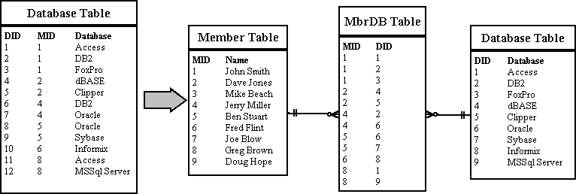
Eliminate Redundant Data

Slide 18
Eliminate Columns Not Dependent On Key
3. Eliminate Columns Not Dependent On Key
The Member table satisfies first normal form - it contains no repeating groups. It satisfies second normal form - since it doesn't have a multivalued key. But the key is MemberID, and the company name and location describe only a company, not a member. To achieve third normal form, they must be moved into a separate table. Since they describe a company, CompanyCode becomes the key of the new "Company" table.
The motivation for this is the same for second normal form: we want to avoid update and delete anomalies. For example, suppose no members from the IBM were currently stored in the database. With the previous design, there would be no record of its existence, even though 20 past members were from IBM!

Slide 19
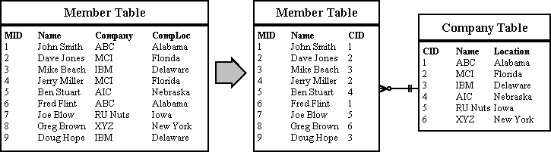
Eliminate Columns Not Dependent On Key

Slide 20
What Is an Index?
  An Index:
  Is a schema object
  Is used to speed up the retrieval of rows by using a pointer
  Can reduce disk I/O by using a rapid access method to locate data quickly
  Is independent of the table it indexes

Slide 21
How Are Indexes Created?
  Automatically: A unique index is created automatically when you define a PRIMARY KEY or UNIQUE constraint in a table definition
  Manually: Users can create nonunique indexes on columns to speed up access to the rows

Slide 22
Creating an Index
  Create an index on one or more columns
CREATE INDEX index
ON table (column[, column]...);
  Improve the speed of query access to the LAST_NAME column in the EMPLOYEES table
SQL> CREATE INDEX emp_ename_idx
2 ON emp(ename);
Index created.

Slide 23
When to Create an index
  You should create an index if
  A column contains a wide range of values.
  A column contains a large number of null values.
  One or more columns are frequently used together in a WHERE clause or a join condition.
  The table is large and most queries are expected to retrieve less than 2 to 4% of the rows.

Slide 24
When Not to Create an Index
It is usually not worth creating an index if:
  The table is small
  The columns are not often used as a condition in the query
  Most queries are expected to retrieve more then 2 to 4% of the rows in the table.
  The table is updated frequently
  The indexed columns are references as part of an expression

Slide 25




Your Global Technology Outsourcing Partner
EPAM Power Point Title
For more information, please contact:
Name
Title
EPAM Systems, Inc.
Princeton Pike Corporate Center
989 Lenox Dr., Suite 305
Lawrenceville, NJ 08648
Phone: +1-609-844-0400
Fax: +1-609-844-0415
http://www.epam.com
® 2004. EPAM Systems. All rights reserved.

